Slide 1
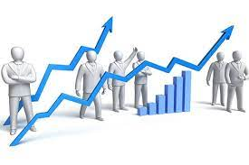
STOCKS FORECASTING AND VISUALIZATION USING DASH
PRESENTED BY TRIBE-L members
GOURI POTDAR
VISHAKA RATHOD
H ANJANA
HEENA NAWAZ
AMBRESH DESAI
SHWETA PAWAR
MEGHANA PASARE
UNDER THE GUIDANCE OF
DINESH BEHERA

Slide 2
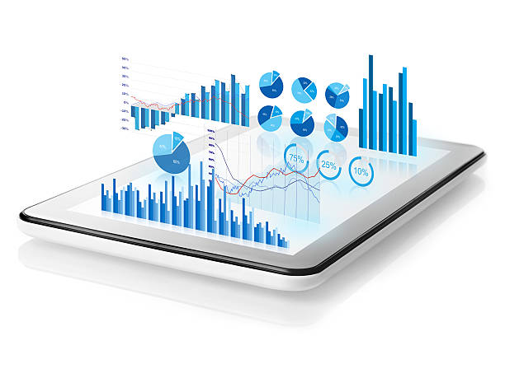
INTRODUCTION
Stock investments provide one of the highest returns in the market. Even though they are volatile in nature, one can visualize share prices and other statistical factors which helps the keen investors carefully decide on which company they want to spend their earnings on.
Stock prices are inﬂuenced by various factors ranging from the performance of the company itself to the conditions of the economy in general. Thus, to manage investment portfolios, stock market data has to be analyzed regularly to identify potential relationships between various stocks, hence to adjust investment based on related stocks trends. A picture is worth a thousand words presenting data in visual form can assist humans in exploring deep insight of vast amounts of complex raw data, especially when people have limited knowledge of the data. Visual representation is one of the most eﬃcient ways to assist investors to have a clear overview of movements of the stock market, as well as providing a deeper understanding of each individual stock.

Slide 3
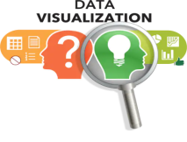
Data visualization refers to the techniques involved in graphically representing data, using visual elements like charts and graphs to spot trends, patterns, and outliers, for quick insights, and to help in real-time decision-making. It's increasingly important in today's world to understand the overwhelming volume of data being generated by businesses every single day.
Because of the way the human brain processes information, using charts or graphs to visualize large amounts of complex data is easier than poring over spreadsheets or reports. Data visualization is a quick, easy way to convey concepts in a universal manner.The visual representation of data, is more scientific than artistic in our modern world. The main goal of data visualization is effectively, efficiently, elegantly, accurately as well as meaningfully communicating information. It fulfills its objectives only if it encodes the given input in such a manner that our eyes can recognize and our brain can comprehend.
In stock market, Data visualization helps traders when making decisions quickly and enables them to easily synthesize large amounts of complex information.

Slide 4
OBJECTIVE
To create a single-page web application using Dash (a python framework) and some machine learning models which will show company information (logo, registered name and description) and stock plots based on the stock code given by the user. Also the ML model will enable the user to get predicted stock prices for the date inputted by the user.
REQUIREMENTS
● Hardware Requirements:
○ RAM: 4 GB
○ Storage: 500 GB
○ CPU: 2 GHz or faster
○ Architecture: 32-bit or 64-bit
● Software Requirements:
○ Python 3.5 and above in Visual Studio code
○ Operating System: windows 7 and above or Linux based OS or MAC OS

Slide 5
● PYTHON LIBRARIES AND TOOLS USED
● numpy library is used for multi-dimensional array operations.
● pandas is used for creating DataFrames to efficiently manage the data.
● yfinance is a library that allows us to fetch financial data of a company (since its listing in the stock market) from its stock code directly.
● gunicorn and lxml libraries will be used for the application's deployment i.e. to host the app on a target server.
● sklearn and scikit-learn are tools used in the development of Machine Learning (ML) models.
● Dash is an open-source Python framework used for building analytical web applications. It is a powerful library that simplifies the development of data-driven applications. Users can create amazing dashboards in their browser using dash.
● Plotly is an open-source library that provides a list of chart types as well as tools with callbacks to make a dashboard.
● Flask is a small and lightweight Python web framework that provides useful tools and features that make creating web applications in Python easier.
● dash_core_components: It is used for making beautiful charts, other visual components such as selectors, drop-downs, dates, and other visualizations.
● dash_html_components: It includes various HTML tags for designing the dashboards. Dash HTML Components are similar to HTML syntax-es, so try relating the two syntax together.

Slide 6
APPROACH
Make the main website's structure using mainly Dash HTML Components and Dash Core Components.
Enhance the site's UI by styling using CSS.
Generate plots of data using the plotly library of Python. The data is fetched using
yfinance python library
Implement a machine learning model to predict the stock price for the dates requested by the user.

Slide 7
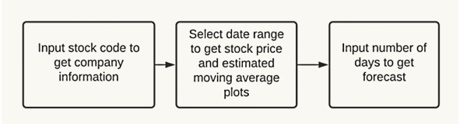
PROJECT STAGES

Slide 8
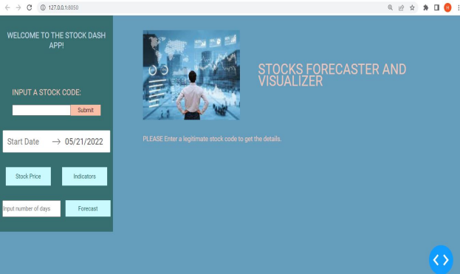
Our web app will look as shown below:

Slide 9
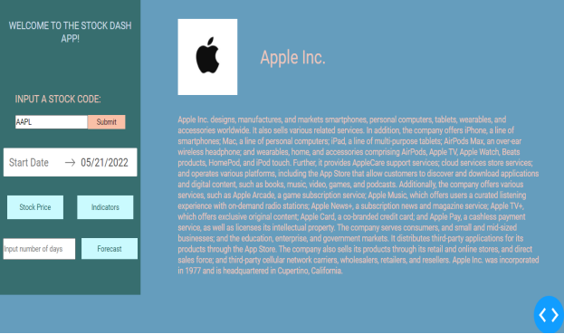
Input a stock code to get company’s information.

Slide 10
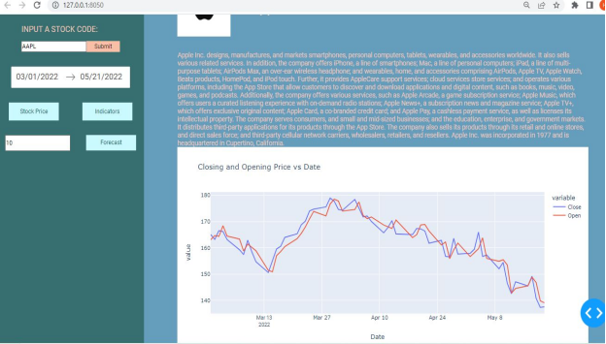
2. Select Date range to get stock price and Estimated Moving Average plots

Slide 11
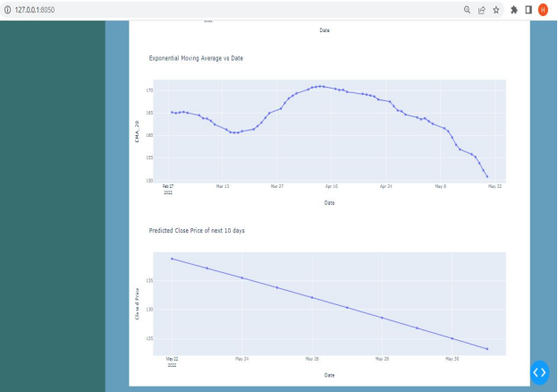
3. Input number of days to get forecast

Slide 12
REFERENCES
● Part 2. Layout | Dash for Python Documentation | Plotly
●Dash HTML Components | Dash for Python Documentation | Plotly
●Dash Core Components | Dash for Python Documentation | Plotly
●CSS Tutorial
●A Complete Guide to Flexbox | CSS-Tricks
●Part 3. Basic Callbacks | Dash for Python Documentation | Plotly
●Build A Stock Prediction Program
●Python LSTM (Long Short-Term Memory Network) for Stock Predictions | DataCamp
●An introduction to Grid Search. This article will explain in simple… | by Krishni | DataDrivenInvestor
●Plotly Express
●Hands-On Guide To Using YFinance API In Python

Slide 13
THANK YOU

